Slide 1


Advanced Materials Characterization
Machine Learning in Materials Sciences
Lingfei Wei
4/18/2019

Slide 2


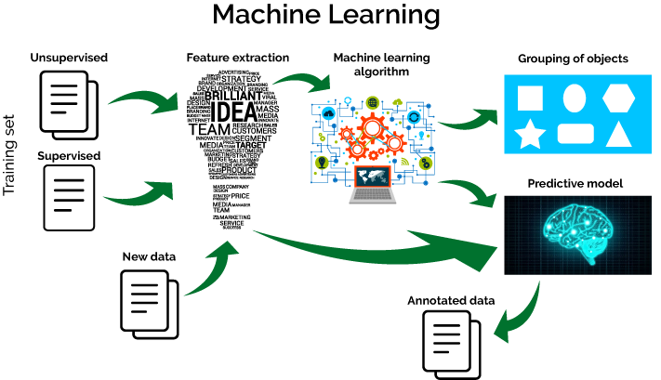
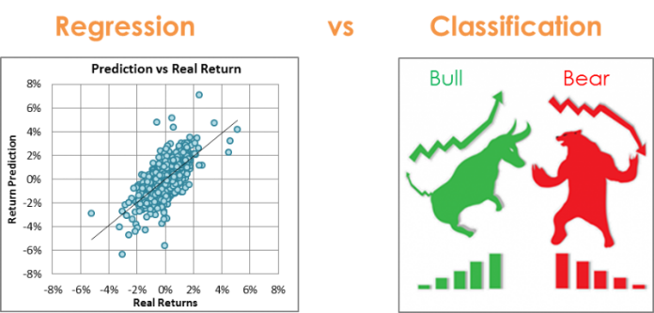
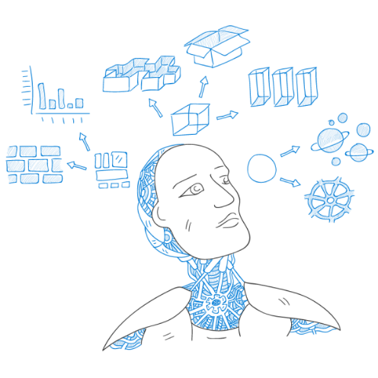
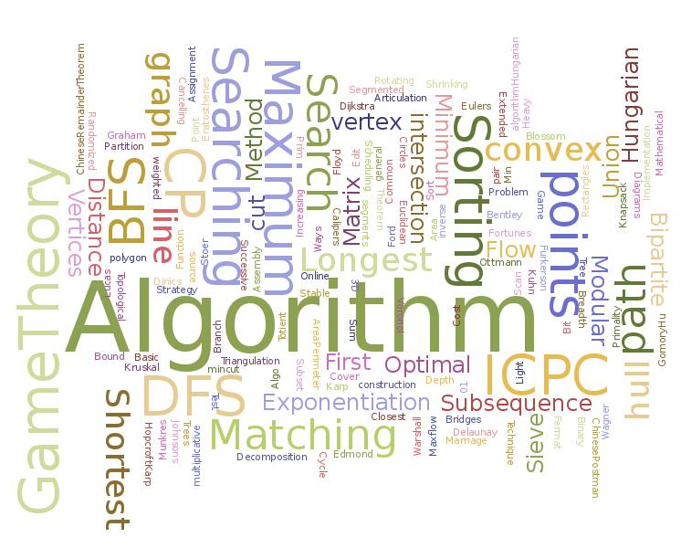

MACHINE LEARNING
Training data
Feature
extraction
Machine learning
algorithm
Classification
Empty
Regression
(predictive model)
Step-by-step
Machine learning types
Machine learning algorithms (Support Vector Machine, SVM)
SVM: mathematics, kernel, hyperparameters
Overfitting & Underfitting: cross validation
Machine learning in materials sciences
3
Notes:
People provide machine with training data or just an environment to let them study features or play games by themselves.
With the help of different ML algorithms, machine can help solving problems such as classification/regression.
1.

Slide 3





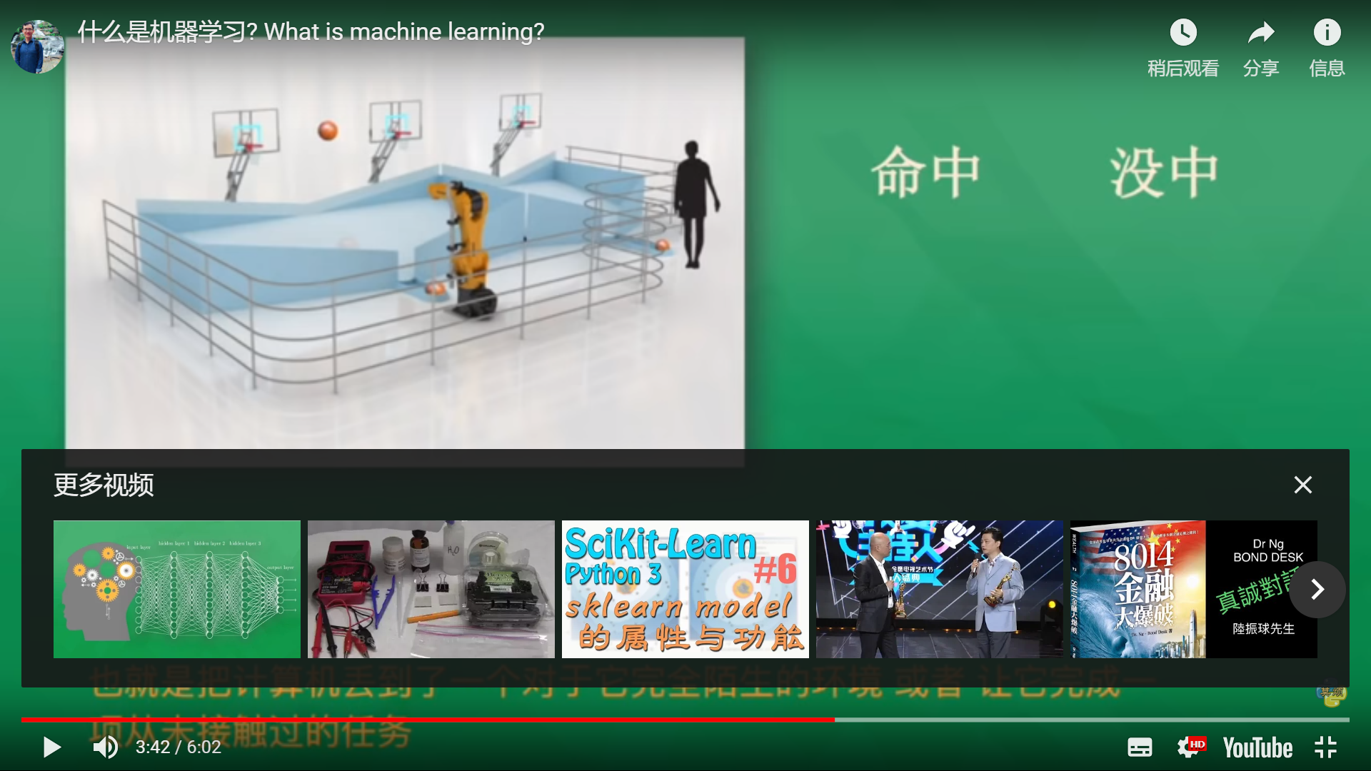

Machine learning types
Supervised Learning
Unsupervised Learning
Reinforcement Learning
Scoring!
Lose
Dog
Cat
Sizes?
Eye?
Ears?
Fur?
Limbs?
4
Notes:
Supervised learning is the most common machine learning type using by scientists form different fields
The machine is asked to shoot at a basket,
we don’t teach him how to shoot just let him play by himself and score each shoot.
So the machine will try different angles, different strength and different positions,
At first, he will lose a lot, but gradually, more and more scoring and can even reach no mistakes
Famous+typical example，chess

Slide 4
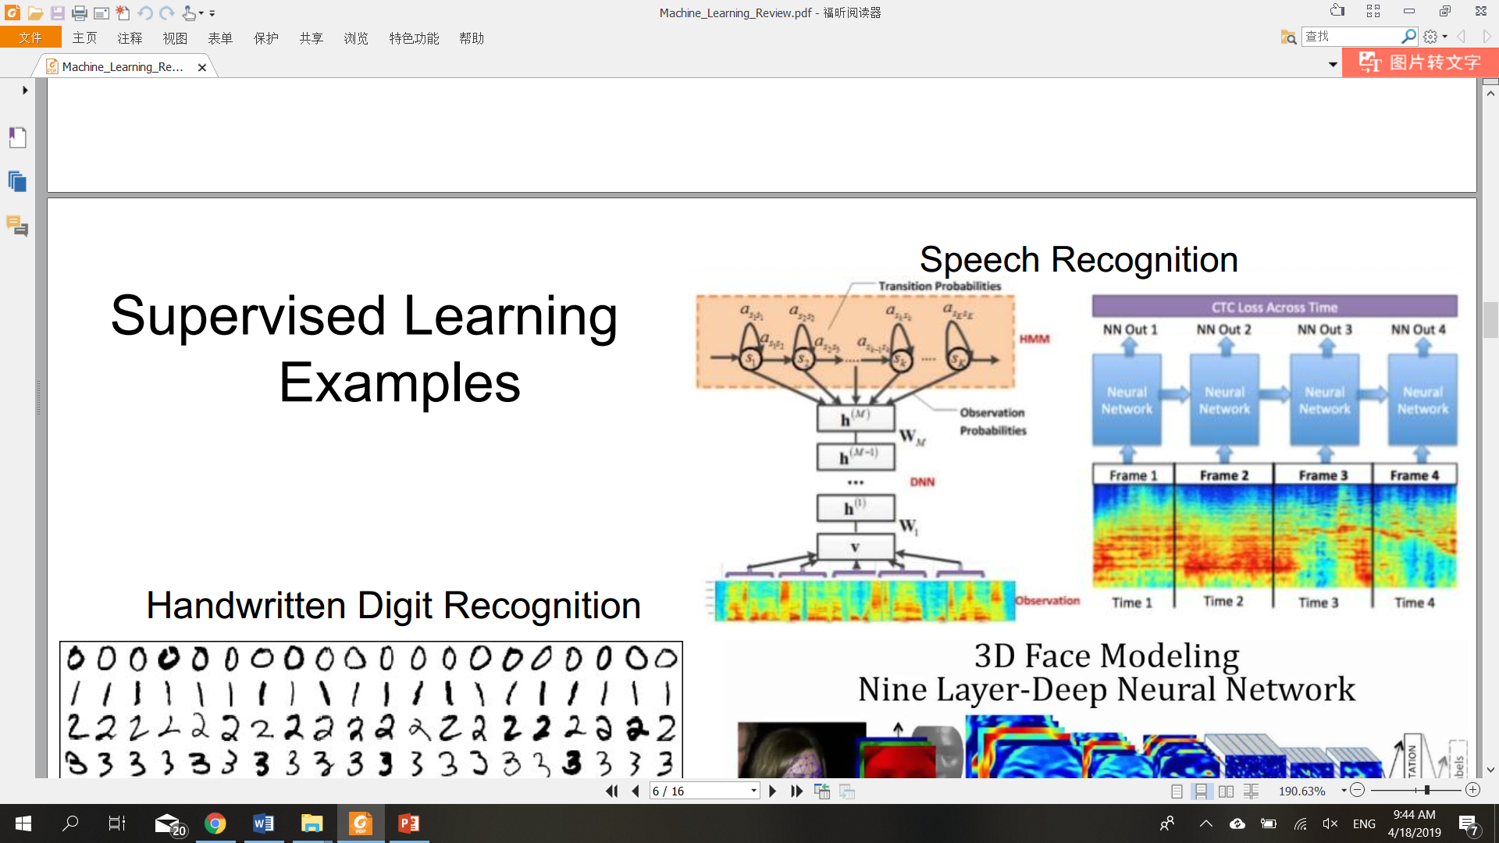
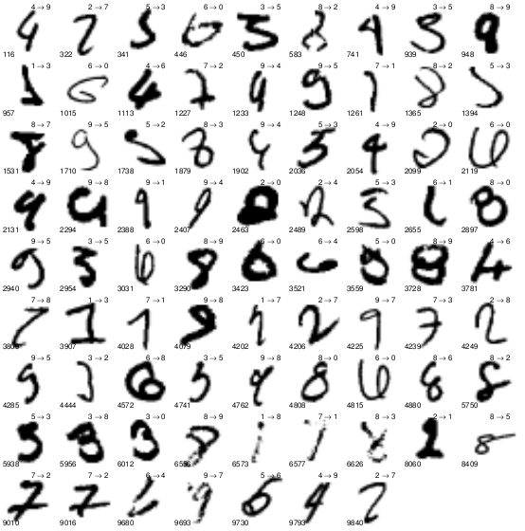
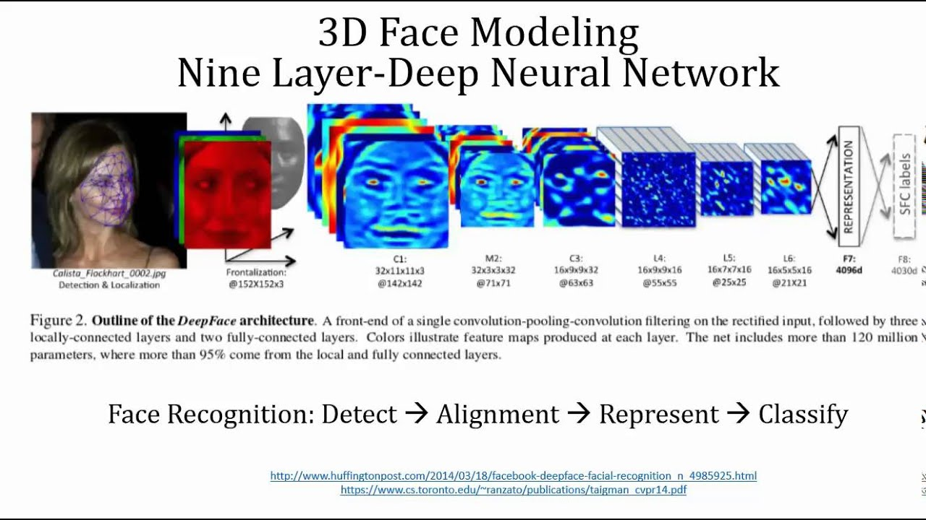
Machine learning types
Supervised Learning Examples
Handwritten Digit Recognition
5

Slide 5
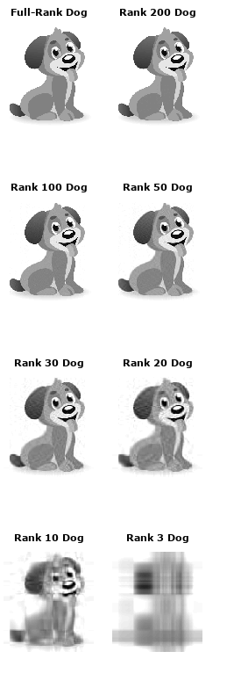
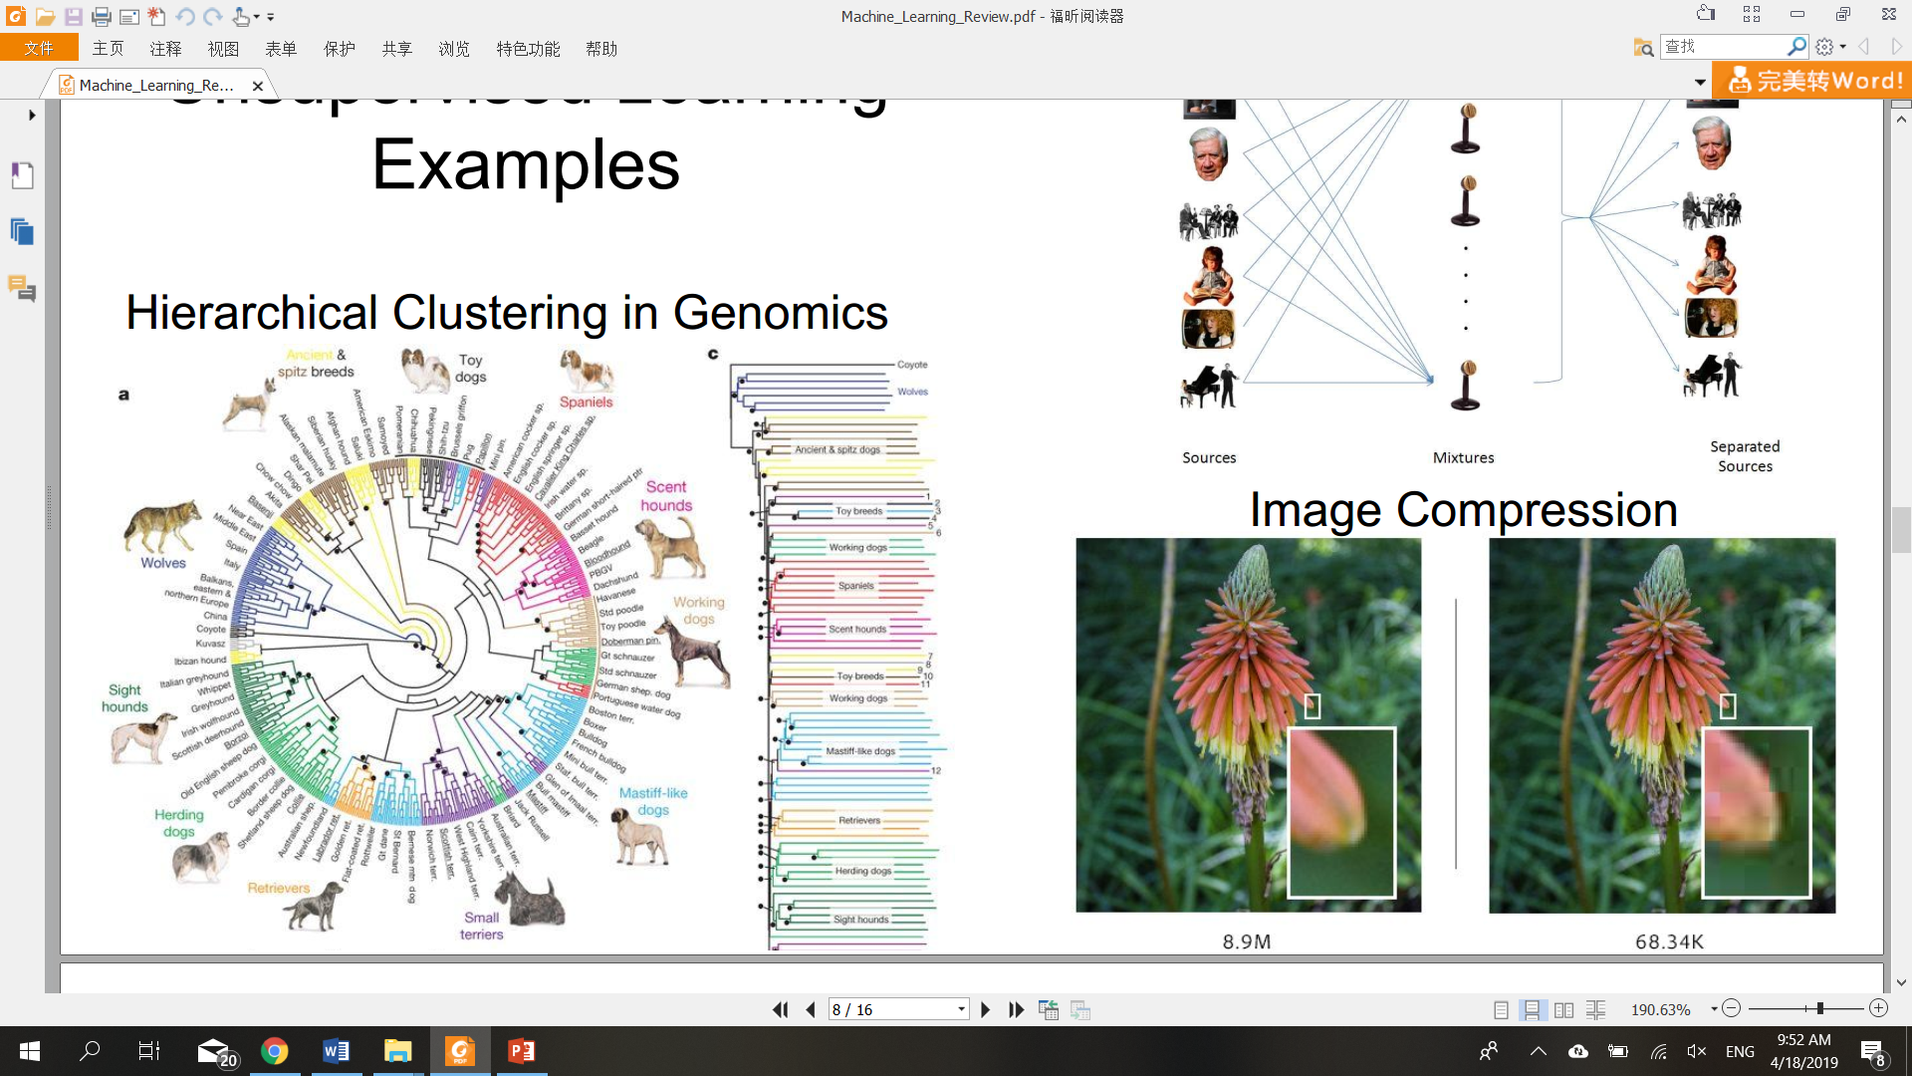
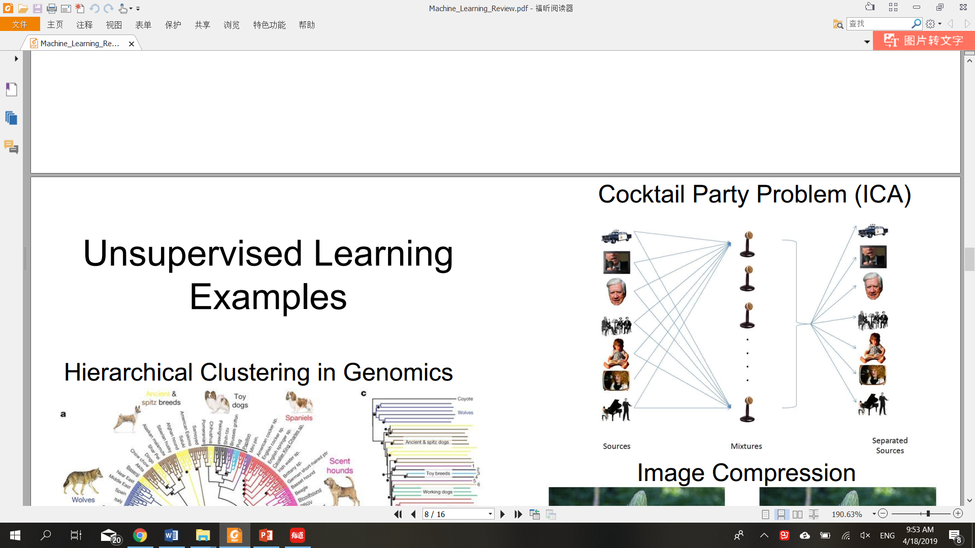
Machine learning types
Image compression
Unsupervised Learning Examples
6
Notes:
Unsupervised learning is often used to preprocess the data. Usually, that means compressing it in some meaning-preserving way like with PCA or SVD before feeding it to a deep neural net or another supervised learning algorithm.

Slide 6
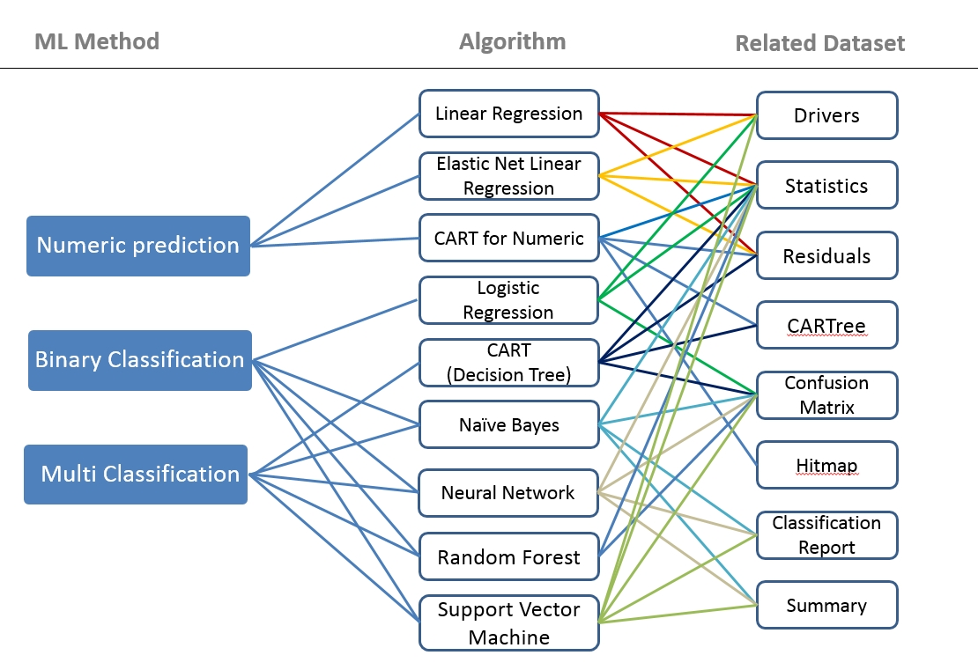
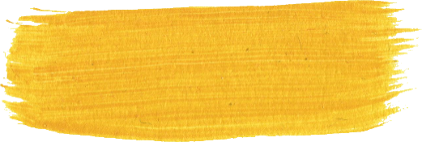
Machine learning algorithms
Support Vector
Machine
7
Notes:
Within these algorithms, linear regression could be the easiest one,
And you may also heard of neural network, random forest.
Here I want to focus on SVM, which is also used in my search

Slide 7
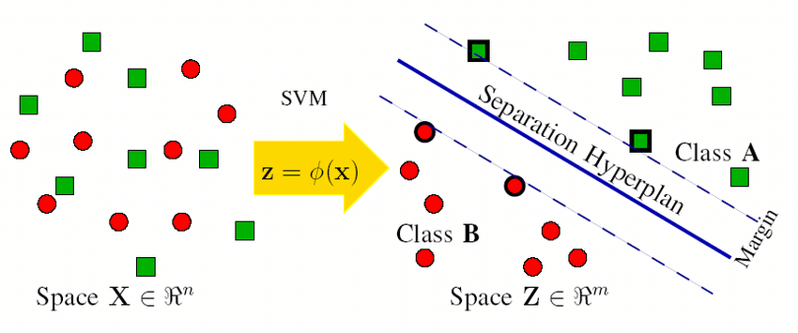
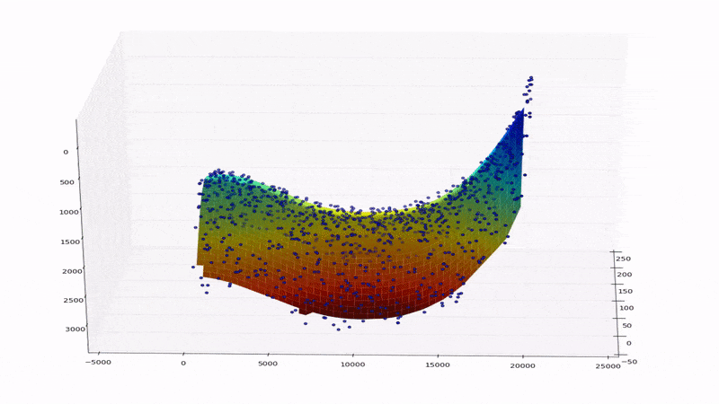
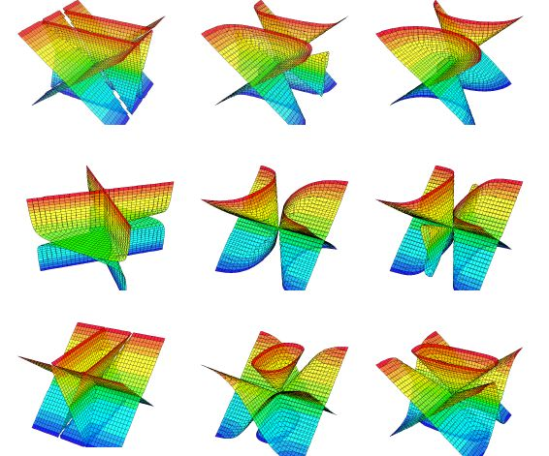
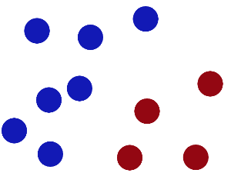
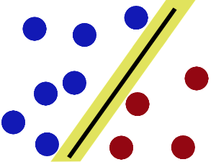
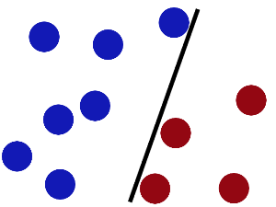
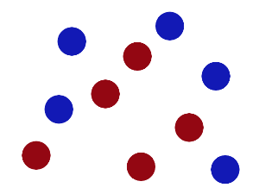

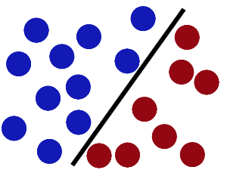
Support Vector Machine
Hyperplane?
To a higher dimensional space?
Separation Hyperplane
8
Notes:
Generally, are supervised learning models with associated learning algorithms that analyze data used for classification and regression analysis.
More formally, a support-vector machine constructs a hyperplane or set of hyperplanes and to solve a problem by transfer it from a low-dimensional space to a higher dimensional space.
Witch capture
exert all your strength and pound the table
suspension
This is easiest explanation of SVM,
the hyperplane can actually be quite complicated like these and somehow you can not imagine
Given a particular hyperplane, we can compute the distance between the hyperplane and the closest data point. Once we have this value, if we double it we will get what is called the margin.
Biggest margin!

Slide 8
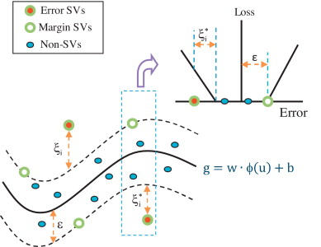
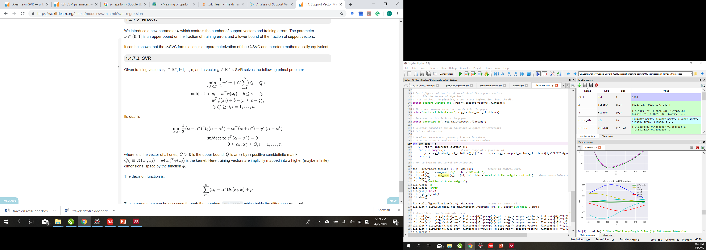
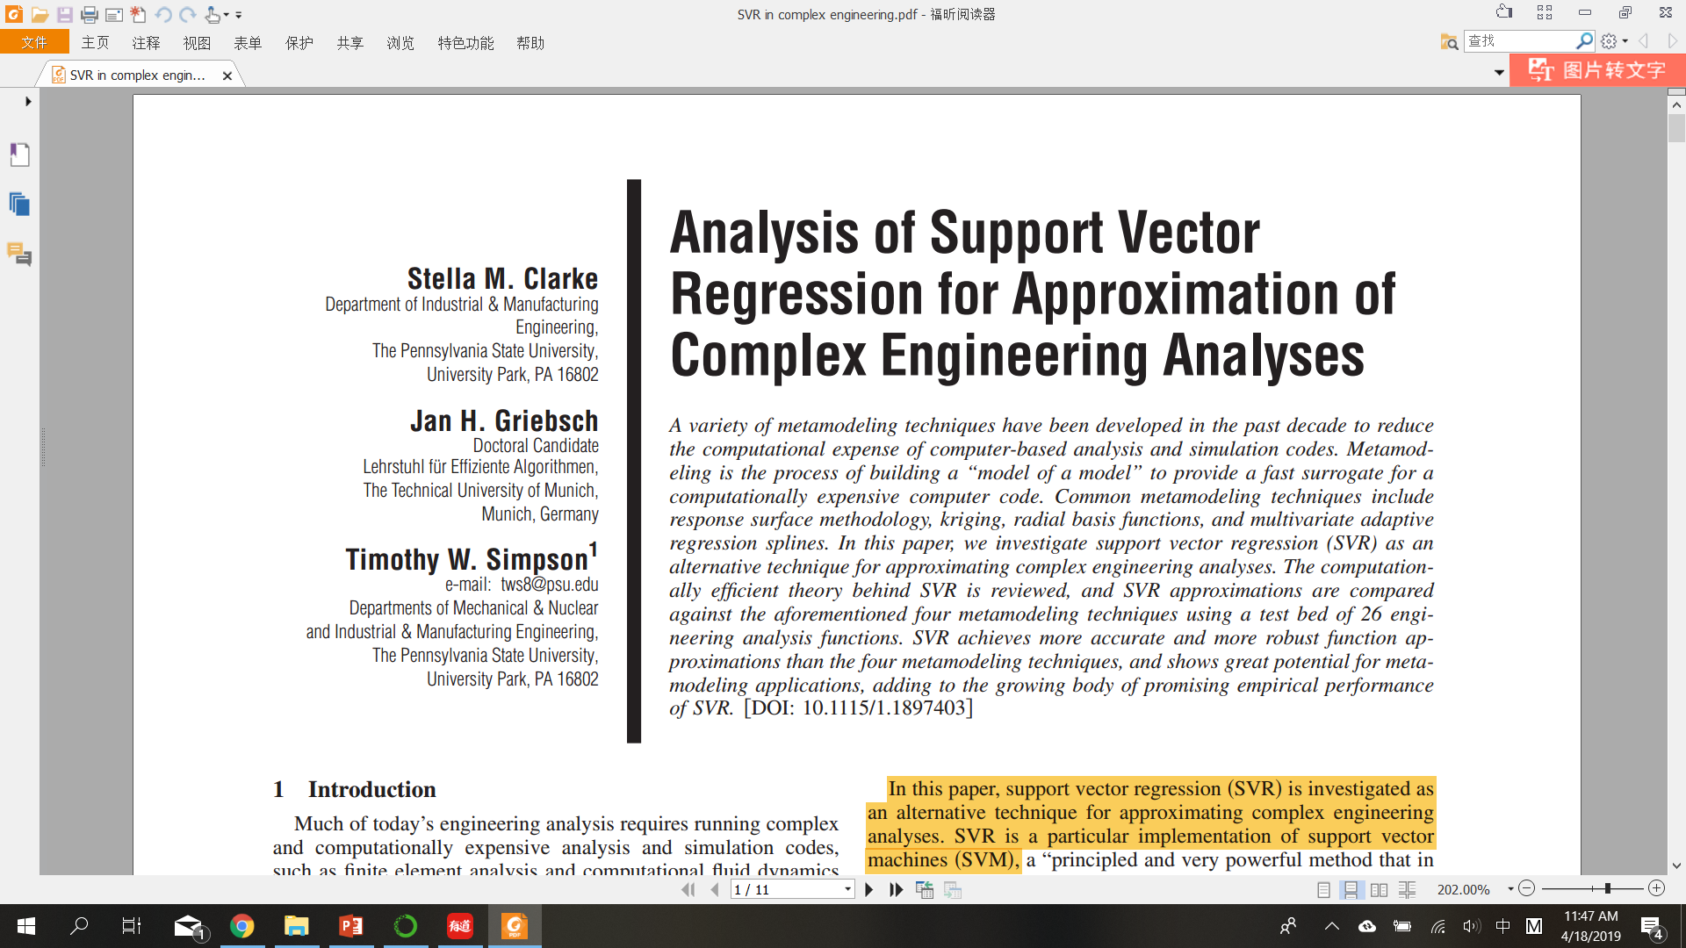
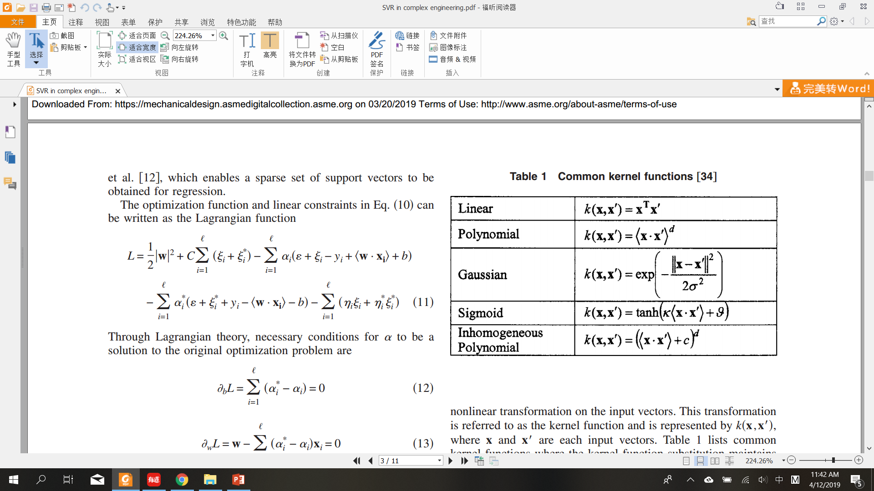
Support Vector Machine: mathematics
Mathematical (linear regression)
Primal problem:
Dual form:
epsilon
9
https://www.svm-tutorial.com/2014/11/svm-understanding-math-part-2/
Notes:
The value of ϵ defines a margin of tolerance where no penalty is given to errors
Data points within the area are not support vectors, those on the edge and outside the area are support vectors.
The ultimate purpose is to minimize error
Through Lagrangian theory, the optimization problem can be transferred to the dual form
To use all support vectors to determine error terms, and to minimize sum of errors from each support vectors
X are support vectors
C, penalty coefficient, a non-negative value, how much we consider of the influences brought by outliers
Gamma to determine

Slide 9
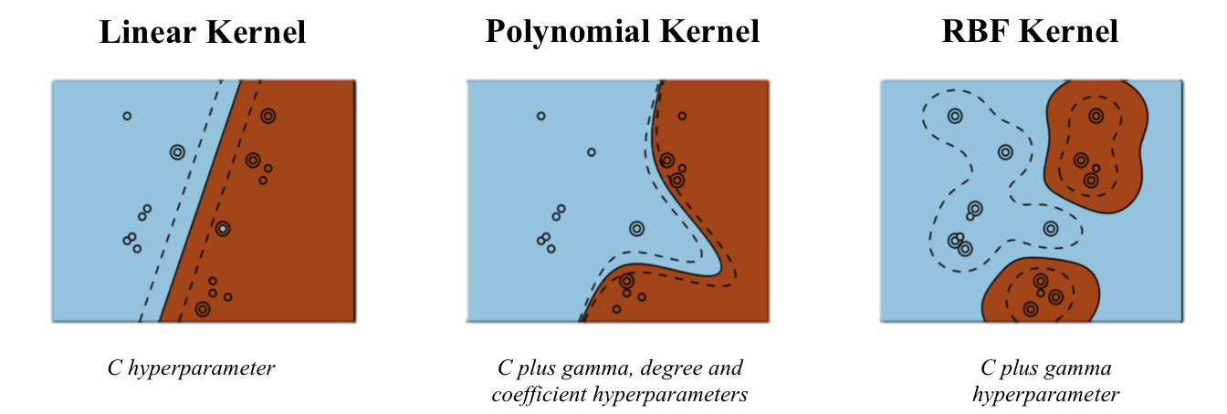
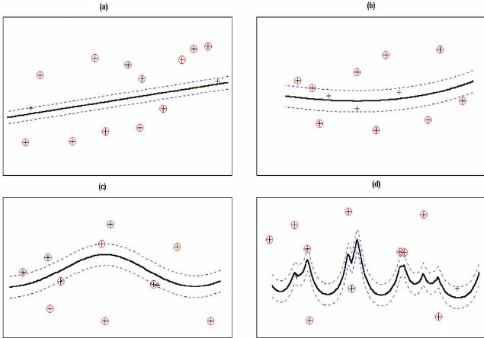
Support Vector Machine: Kernels & Parameters
(Radial basis function)
SVC
SVR
10

Slide 10
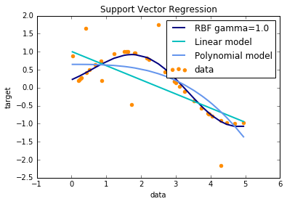
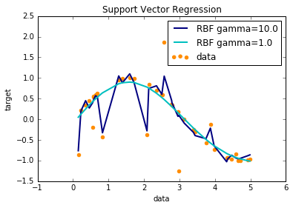
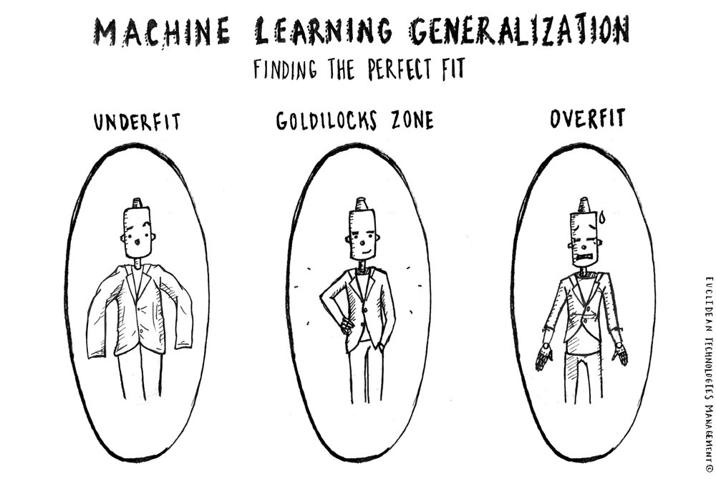
Support Vector Machine: Kernels & Parameters
Underfitting & overfitting
11
Notes:
Overfitting happens when a ML model overemphasizes the data on which it was trained and therefore loses its applicability to other datasets.
Underfitting happens when a ML model fails to accurately capture relationships between a dataset’s parameters and its target variable.

Slide 11
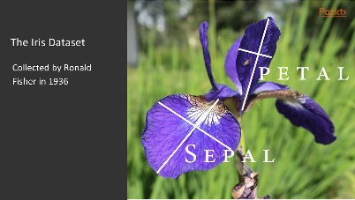
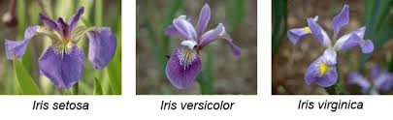

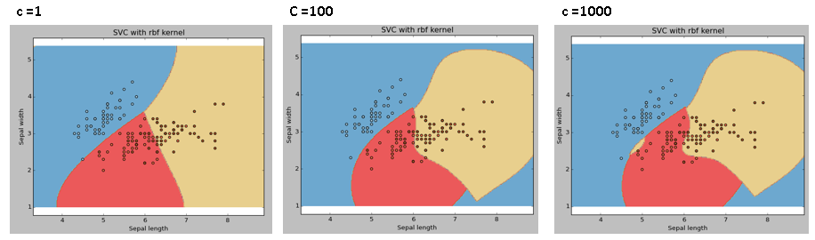
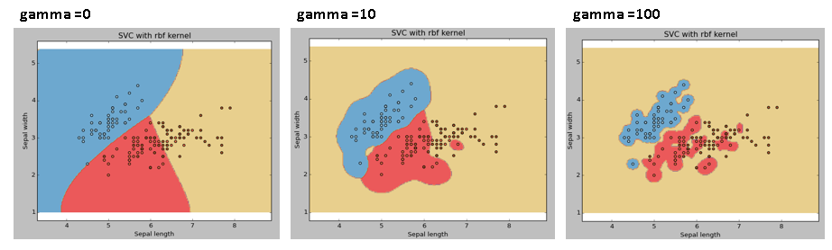
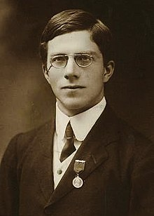
Support Vector Machine: Kernels & Parameters
C: Penalty parameter C of the error term
gamma: Kernel coefficient for ‘rbf’, ‘poly’ and ‘sigmoid’
12
Notes:
1936
it’s important to determine the values of parameters, which can influence the classification/regression results, for example:
The C parameter trades off correct classification of training examples against maximization of the decision function’s margin
gamma:
The Higher gamma value will try to exact fit every training data so can bring problems like overfitting

Slide 12
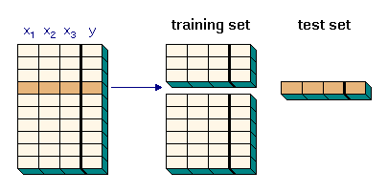
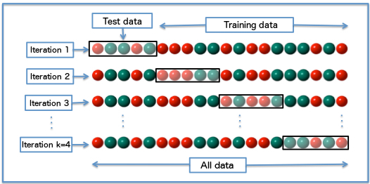
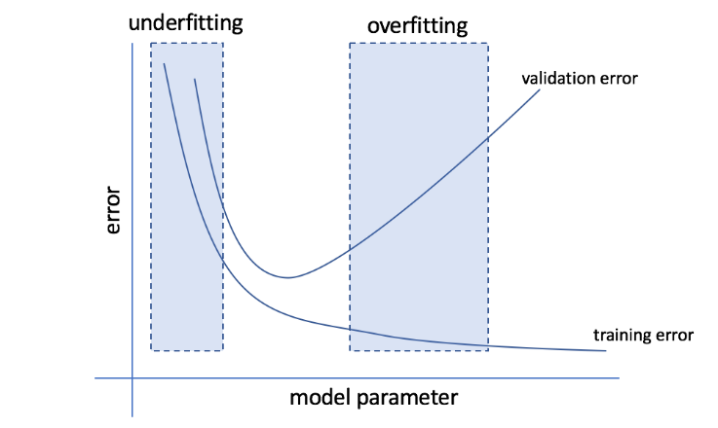
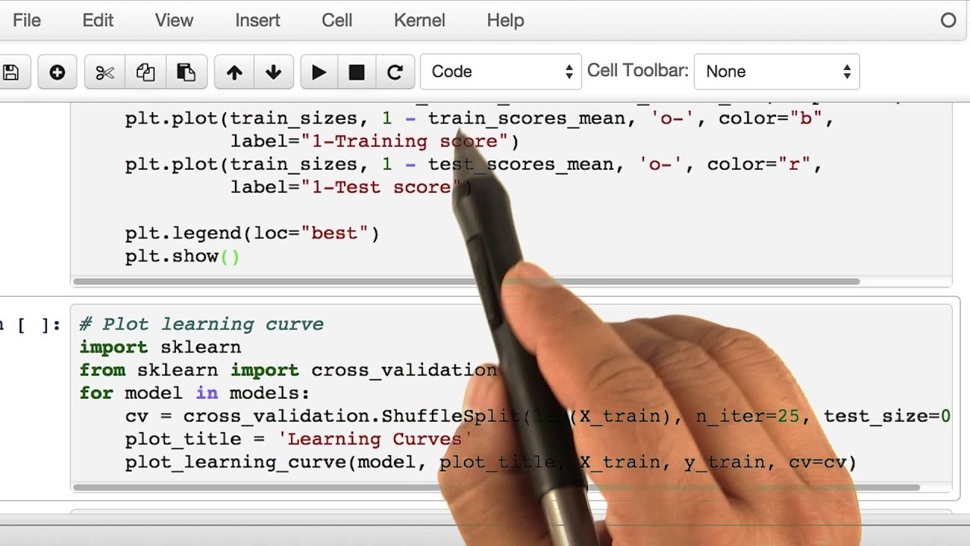
Support Vector Machine: Cross validation & Learning curve
K-fold cross validation
13
Notes:
People use different ways to optimize parameters and to visualize the training process
One very famous is cross validation,
And in order to minimize the influence of sample selections, k-fold cross validation has been used in many cases
When the cross validation is applied for k times and different training data/test data are used in each time
Errors: mean squared variance…accuracy for calssification

Slide 13
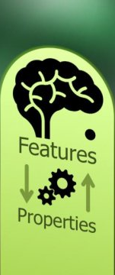
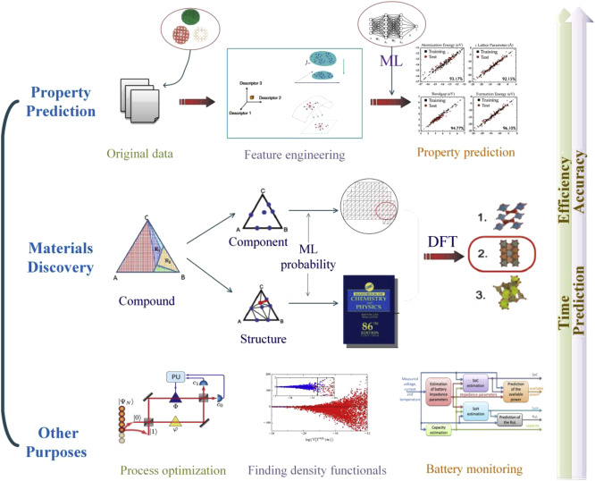
Machine Learning
@ Materials Sciences
14
Reference: Liu, Yue, et al. "Materials discovery and design using machine learning." Journal of Materiomics 3.3 (2017): 159-177.
Notes:
Prediction of properties, structures
Discover new materials with certain character
Process optimization, help with Density Function Theory and monitor batteries

Slide 14
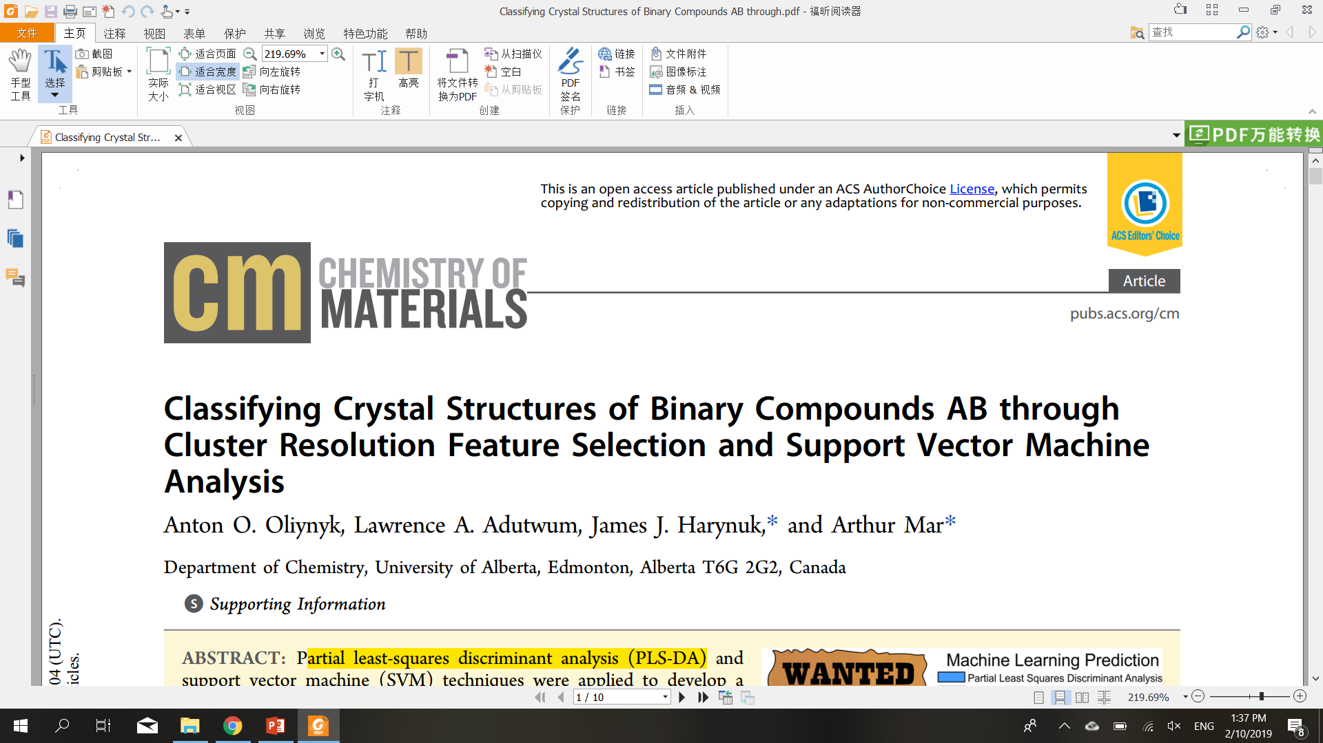
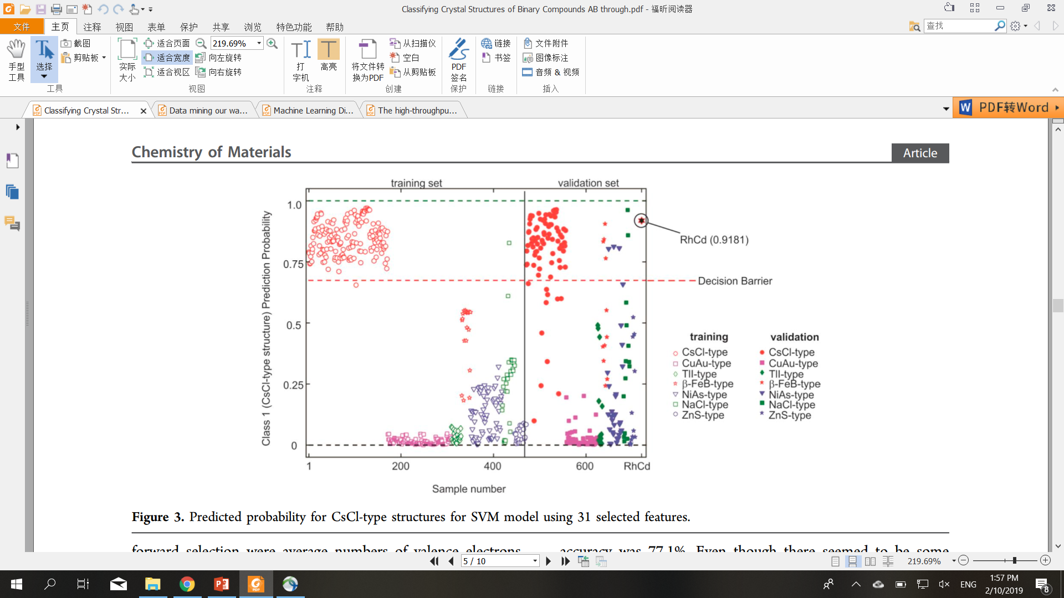
Targets: Binary compounds AB
Goal: prediction of crystal structures
Database: Pearson’s Crystal Data and ASM Alloy Phase Diagram Database (706 samples)
Methods: Partial least-squares discriminant analysis (PLS-DA) and support vector machine (SVM)
Figure. Predicted probability for CsCl-type structures for SVM model using 31 selected features.
15
Notes:
For the first case, the author want to classify the crystal structures for AB type compounds use

Slide 15
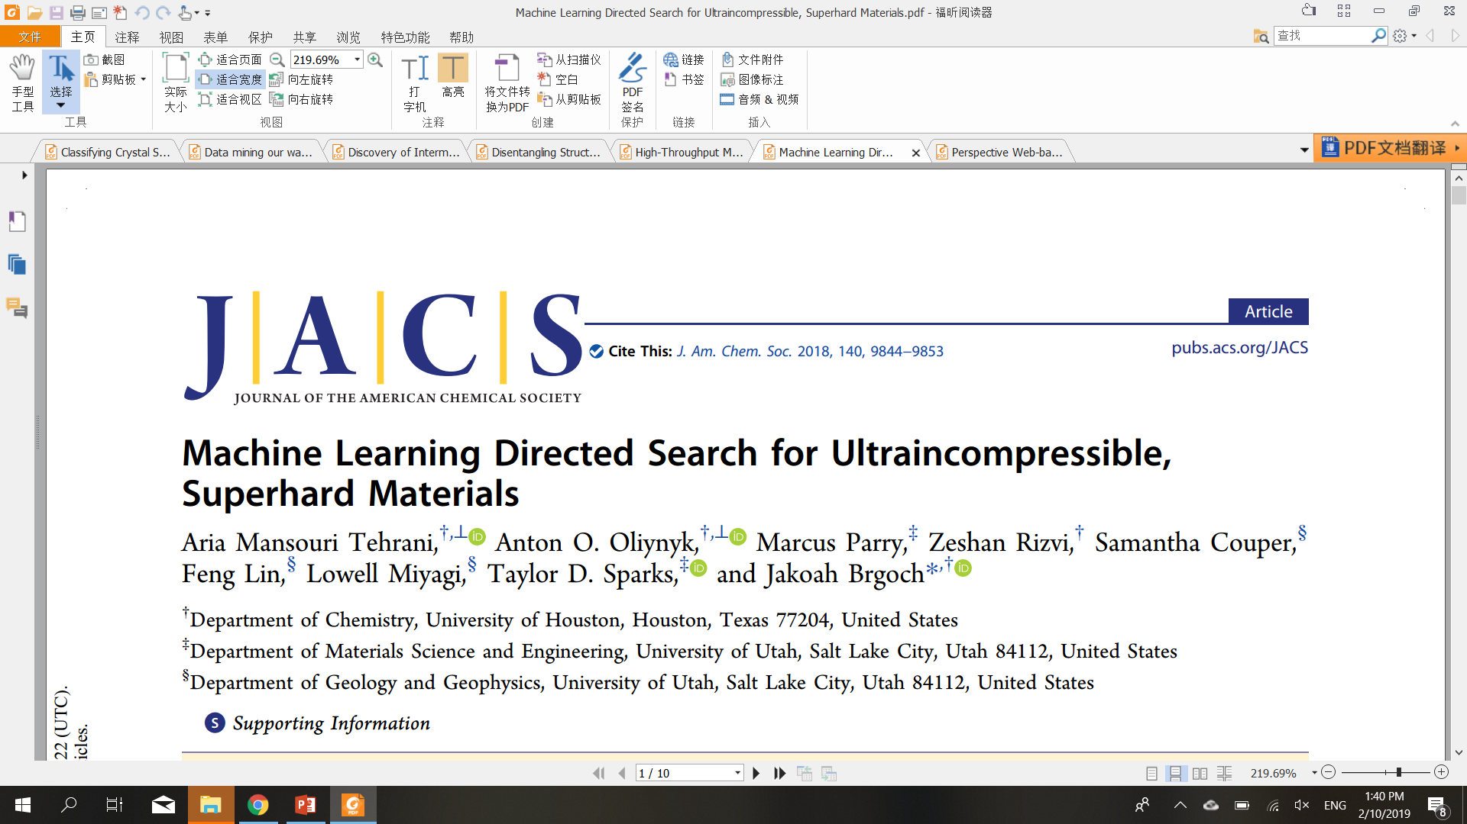
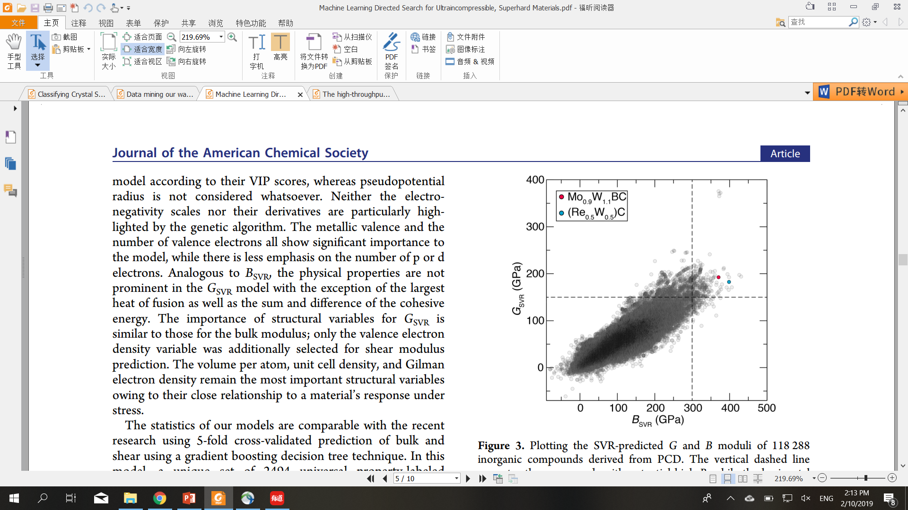
Targets: Binary, ternary, and quaternary inorganic solids
Goal: Ultraincompressible, Superhard Materials
Database: Pearson’s Crystal Data and Materials Project data (118287 samples)
Methods: Support Vector Machine Regression (SVR) and radial basis function (RBF) kernel
Figure. Plotting the SVR-predicted G and B moduli of 118 288 inorganic compounds derived from PCD.
16
Notes:
For this one, the authors using SVR and RBF kernel to predict ulrtaincompressible and superhard materials
Both of these authors use the training data from published data online, some open-access database
Where you can also find the information you want

Slide 16
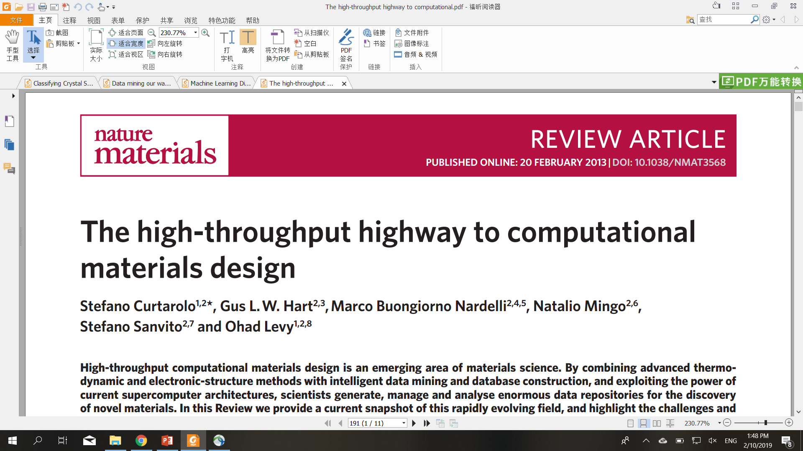
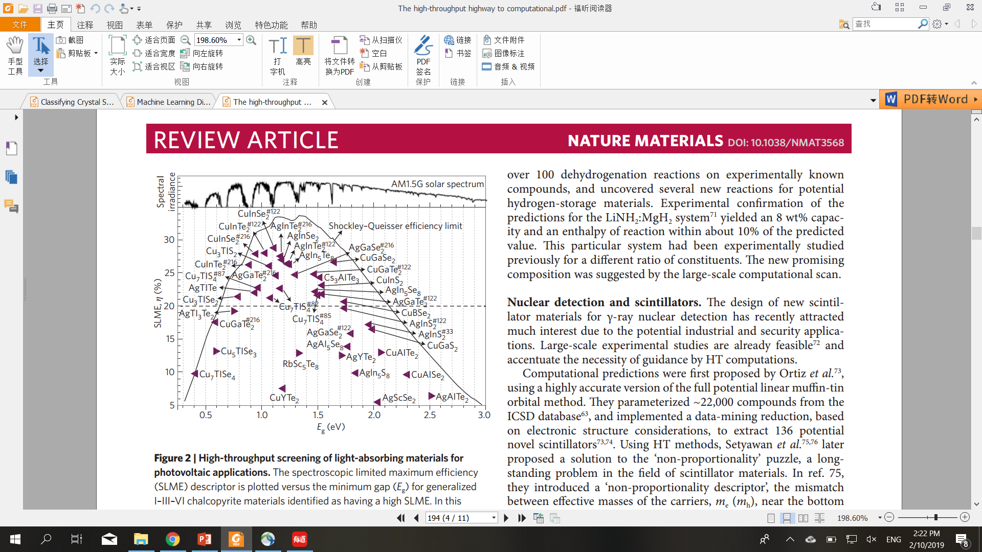
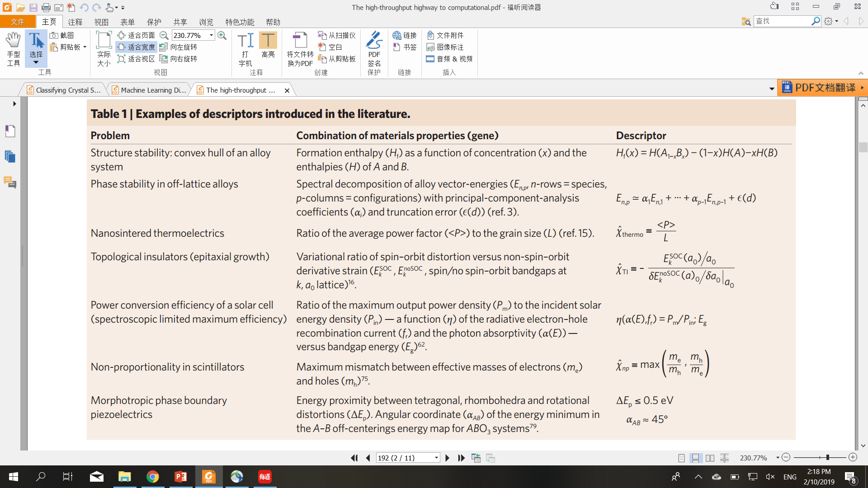
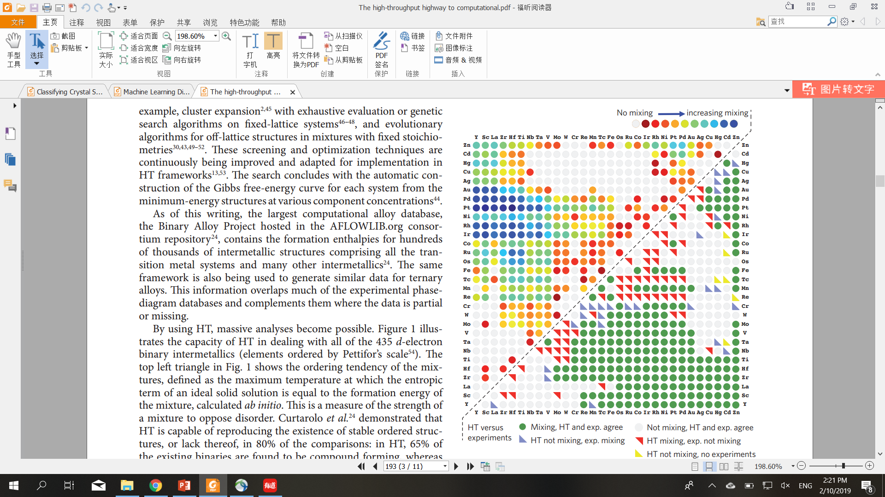
17
Notes:
Also, this is a review article from nature materials, summarizing many different applications of machine learning in materials design, which you may find it inspiring

Slide 17
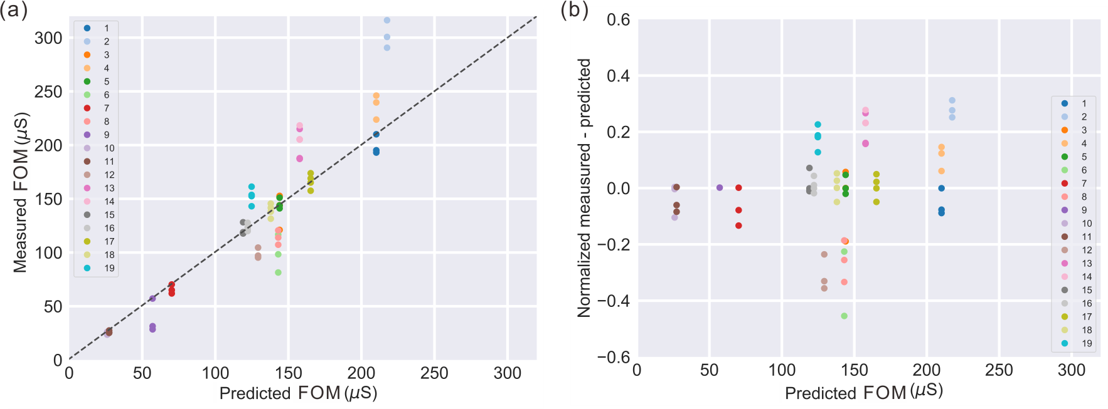


Cu/Zn ratio
Concentration of Na₂EDTA
Reaction temperature
Reaction time
Full factorial
Singer factorial
Fractional factorial
4^4=256!
4x4=16!
Area of interest
Design of Experiment
Machine Learning
18
Notes:
So that I can cover every possibilities
Outside consideration
For the best consideration
With properly design of experiment, I can use this data to do machine learning regression
Contour map, area of interest to guide the experiment and device fabrication

Slide 18


Acknowledgment!
Notes:
I can find all these resources and interesting pictures
Hopefully, everybody can take maximum advantage of machine learning in your researches.

